Slide 1

Fall Detection Justin Haryanto
Nhan Nguyen

Slide 2
Objectives
Improve fall detection performance
Functions with low quality video and unusual poses
Fast and works on a live feed
Tracks multiple people
Does not require personal devices and sensors

Slide 3
System Overview
Video
Video Processing
Pose Estimation
Fall Detection
Output

Slide 4
System Overview
Video Processing
Fall Detection
Pose Estimation
Fall Detection
System

Slide 5
Execution plan
Completed
In Progress
Not Started
Goal | 9/5 | 9/19 | 10/3 | 10/17 | 10/31 | 11/14 | 11/28
Review Literature on Pose Estimation (Both)
Experiment with Pose Estimation programs (Both)
Improve Performance of Pose Estimation Programs (Nhan)
Study Machine Learning (Justin)
Implement ML & DL on keypoints & bounding boxes (Justin)
Fall Detection Dataset (Justin)
Train Fall Detection (Justin)

Slide 6
Validation plan
Test | Success Criteria | Methodology | Status | Responsibility
Pose Estimation FPS | Processes videos at 30 FPS | Feed videos at various FPS | Untested | Nhan Nguyen
Fall Detection Accuracy | >90% of falls successfully detected | Use processed videos, compare to labelled dataset | Untested | Justin Haryanto
Whole System Accuracy | >90% of falls successfully detected | Use raw videos, compare to labelled dataset | Untested | Full Team

Slide 7
Video Processing & Pose Estimation - Progress
Studied how AlphaPose works and tested the code on data sets
Examined the output of AlphaPose to see the results of bounding boxes and keypoints

Slide 8
Video Processing & Pose Estimation - Plans
Improve AlphaPose capabilities by altering the code or improving the pre-trained models
Supply live video feed through model

Slide 9
Video Processing & Pose Estimation - Issues
Need to understand code to improve its mean average precision
Issues feeding live video to program

Slide 10
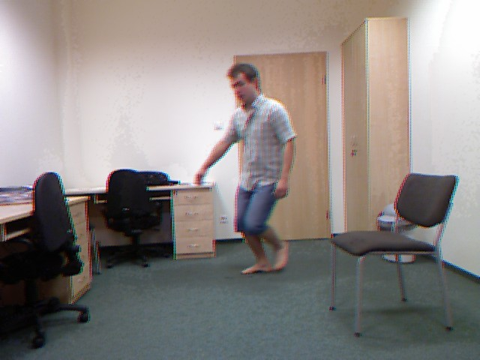
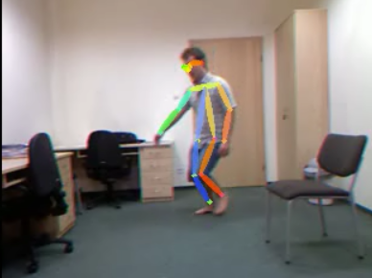
AlphaPose

Slide 11
Fall Detection - Progress
Focused on analyzing keypoints
Used currently labeled AlphaPose data for training and testing
Researched viability of K-nearest neighbors and random forests for fall detection
Currently implementing random forests algorithm

Slide 12
Fall Detection - Plans
Implementing random forests (RF) algorithm on keypoints
Utilizing convolutional neural networks (CNN) to analyze bounding boxes
Fall detection result based on results of RF and CNN

Slide 13
Fall Detection - Issues
Unfamiliarity with Google Colab and TensorFlow
Problems running random forests
Starting training on AlphaPose data
General programming and troubleshooting pain

Slide 14
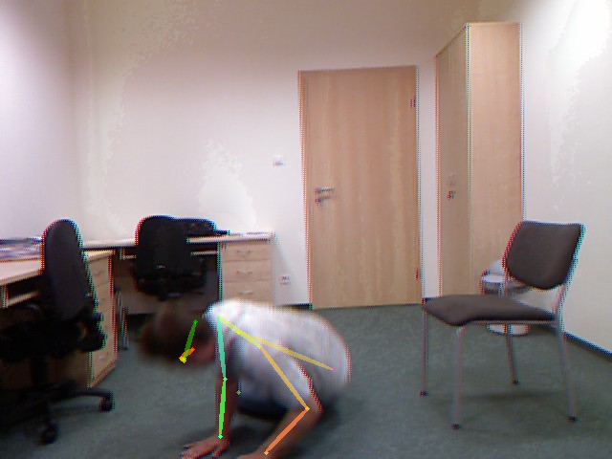
Fall
Detection
FALLEN

Slide 15
Thank You

